Slide 1
ME 496
HUMAN FACTORS &ERGONOMICS

Slide 2
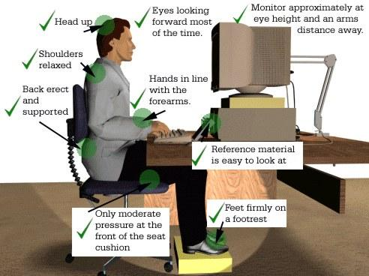
Ergonomics Defined
The science of fitting a job to a worker.
It is mainly concerned with the field of the human operator and his working environment.

Slide 3
Introduction
Human Factors or Ergonomics:
A scientific discipline concerned with the understanding of interactions among humans and other elements of a system, and
A profession that applies theory, principles, data and methods to design in order to optimize human well-being and overall system performance.

Slide 4
Introduction
Human Factors Specialists or Ergonomists contribute to
the design and evaluation of tasks, jobs, products, environments and systems in order to make them compatible with the needs, abilities and limitations of people.
In the work environment, ergonomics also helps to increase productivity by reducing worker discomfort and fatigue.

Slide 5
Ergonomic Applications in Operations Management
In the early 1900s, Frederick Winslow Taylor, known as the father of scientific management, found that the amount of coal that workers could shovel could be increased substantially by reducing the size and weight of the shovels.
Frank and Lillian Gilbreth expanded Taylor's work, developing a set of motion study principles intended to improve worker efficiency and reduce injury and fatigue.
Technological changes have broadened the scope of ergonomics.
More recently, the increasing level of human -computer interfacing has again broadened the scope of the field of ergonomics, not only in job design, but also in electronics product design.

Slide 6
Scope of Course
This course introduces you to Human Factors Engineering. It explores :
Human Error and
Human Capabilities,
Engineering Anthropometry and
Workspace Design.

Slide 7
SYSTEMS AND People
Human factors is the discipline that tries to optimize the relationship between technology and humans.
Anywhere you find technology and people interacting, there is a need for human factors.
But technology goes beyond machines.
Buildings, rooms, noise, and heat also affect how the human interfaces with technology.

Slide 8
Learning Objectives
Discuss the person-machine systems;
Define system goals;
Identify the levels of technology that human factors specialists have to deal with;
Discuss the process of allocation of functions for the human factors specialist.

Slide 9
Person-Machine Systems
- is an arrangement of people and machines interacting within an environment in order to achieve a set of system goals.
Figure 1-1 highlights those portions of the person-machine system that are of greatest importance to human factors.
It neglects other important aspects of machines and people that are less crucial to human factors.

Slide 10
Person-Machine Systems

Slide 11
Defining System Goals
Designers of a person-machine system must have a goal
System goals are specified by management (or by a customer) and the human factors team is simply given a set of goals to accomplish
Trade-offs among goals are seldom clearly specified.
Thus, a prudent human factors team will spend some time analyzing a list of system goals and even going back to management for clarification when goals conflict.

Slide 12
Defining System Goals
Let us suppose we have been hired to create a list of system goals for the postal service.
Desirable goals:
Speedy service;
Frequent mail delivery;
Home delivery to all Ghanaian residents;
Low cost;
Guaranteed transit time.

Slide 13
Level of Technology
Two schemes for classifying levels of technology
General level of complexity and detail
Contributions of people and machines to the total system

Slide 14
Technology Classification Based on Complexity and Detail
This scheme has three levels of complexity.
.
First and Lowest Level
Concerns relatively simple responses to the components of the system such as its knobs and dials. The focus of interest is the individual element rather than the general system
Ergonomist must keep track of many small details
Second Level
Flow of behaviour is more important than individual components
Will include tasks like tracking and driving a car along a winding road
Third and Highest Level
Involves the total system and decisions as to what tasks should be performed by people and what other tasks by machines
Specialist is concerned with more general human capabilities, such as
avoiding an overload of information.
This third level also includes relationships between people and their environments.

Slide 15
Classifying Technology using Contributions of People and Machines to Total System
At the lowest level, the person supplies both power and control to the system.
Machine supplies power, while the human still exercises control.
Machine supplies power and information while the human still controls.
Machine supplies power, information and control, person monitors operation

Slide 16
The first and lowest level

Slide 17
At the second level

Slide 18
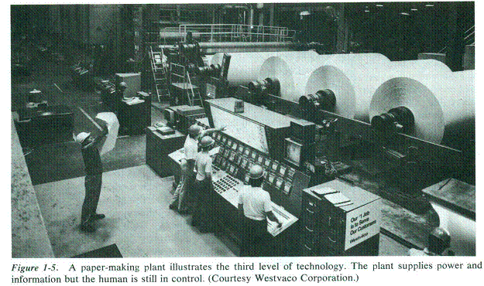
The third level

Slide 19
Fourth Level

Slide 20
Summary of Second Scheme of Classification of Technology
 | Machine | Human Being
Level 1 |  | Power & Control
Level 2 | Power | Control
Level 3 | Power & Information | Control
Level 4 | Power, Information & Control | Monitor

Slide 21
Question ?
At which of the four levels is human factors most needed?

Slide 22
Use of Human Factors
Most people would select the fourth level, since it uses the most sophisticated technology.
People tend to associate human factors with high technology.
However, this is incorrect.
Human factors is needed at all four levels.
As long as people are required to function in systems at all four levels, society gains improved productivity by using human factors.

Slide 23
Uses of Human Factors
Human factors is more difficult to apply at higher levels, because of the great system complexity and this implies more choices for system designers.
This large number of choices takes longer to analyze.
Since there is a trend to more sophisticated technology, where the human is a monitor of system behaviour rather than an active controller, more human factors efforts will be aimed at this level.

Slide 24
Critical Philosophical Question
Before the Ergonomist can get down to work, a more general philosophical question must be raised.
One approach to human as monitor realizes that most of the time the system works quite well without human intervention.
Indeed, the system often will work better if the human keeps hands off.
This will, on the average, decrease the opportunity for human error and so increase system reliability.
Furthermore, it will lower operating costs by substituting machines for people.

Slide 25
Second Philosophical Position
Keeps the human operator involved as much as possible in the system, even if this means creating artificial tasks, such as logging in display readings by hand, to keep the person busy.
Thus, should a machine part of the system fail, the human will be able to leap in and fix the problem.
Thus, this philosophy argues that if you want to land a probe on the moon, it is best to have human astronauts along in case something unexpected goes wrong.
The human is clever and adaptive and can often solve unanticipated problems.
This takes us to the next topic, dividing work between people and machines.

Slide 26
Question?
Which philosophy do you believe in or which should your company adopt?

Slide 27
Guide to Including Human Beings
Do not include a human in a system when there is little for the person to contribute.
In fact, such an undemanding job is quite stressful and unpleasant.
Human factors expert has an obligation to provide meaningful work for people.

Slide 28
Allocation of Functions
Allocation of function is the process whereby the designer decides which tasks (or functions) should be given (or allocated) to the machine sub- system and which to the human subsystem.
For example, a machine is better at performing 100 arithmetic calculations within 10 seconds or lifting 500 pound castings. A person is better at recognizing patterns embedded in noise.

Slide 29
Allocation of Functions
In real life the designer tries to delegate as many functions as possible to machines.
The human gets stuck with the leftover functions.
There must be a rational deliberative process to carefully decide if the person or the machine is better suited to some specific task.

Slide 30
Allocation of Functions
The reliability of machines can be increased less expensively than can the reliability of people by putting extra components in parallel.
At one time, the machine subsystem was almost entirely hardware so that subsequent changes were difficult and expensive.
Now, software (computer programs), is as important as hardware in many machine subsystems. Software can be changed fairly easily.
The human was allocated some functions in older systems to allow flexibility for change. Now this flexibility can be achieved through software modification making it practical for the designer to allocate even more functions to the machine.

Slide 31
Allocation of Functions
Therefore, the major decision in allocation of function involves checking that the human is left with a reasonable set of tasks.
These tasks should neither overload nor underload the operator's capabilities.
In the case of overload it may be necessary to add a second human operator if the machine cannot assume more tasks.
In the case of underload, it may be advantageous to either take some tasks away from the machine or to have the human perform them in parallel with the machine.
In this latter case, the parallel tasks must be structured so that the human feels they are necessary and important.

Slide 32
Allocation of Functions
Some systems give the human the option of changing allocation of function on-line (in real time as the system is operating).
A simple example is the cruise control on your car. Engaging the cruise control allocates part of the workload, maintaining a constant vehicle speed, to the machine subsystem. There are times when such an allocation is desirable and other times when it makes more sense for the human to control vehicle speed.
The human controls allocation of function by deciding whether or not to engage the cruise control.

Slide 33
Achieving System Goals
In order to achieve system goals, designers must proceed systematically.
The following convenient set of seven relevant questions can serve as a checklist for human factors specialists.
1. What inputs and outputs must be provided to satisfy system goals?
2. What operations are required to produce system outputs?
In the postal example, some necessary operations would be sorting mail and transporting it.
3. What functions should the person perform within the system?

Slide 34
Achieving system Goals
4. What are the training and skill requirements of human operators?
More complicated machine subsystems do not necessarily imply lower personnel requirements. For example, the newer nuclear power plants with computer-driven control rooms require additional training because the operator has many more choices in calling up information on the CRT (cathode ray tube) display.
5. Are the tasks demanded by the system compatible with human capabilities?
As mentioned earlier, the designer must avoid tasks that create either overload or underload for the human operator.

Slide 35
Achieving system Goals
6. What equipment interfaces does the human need to perform the job?
The specialist will devote a great deal of time to determining optimal displays and controls, operating procedures, and informational diagnostics.
7. Does the person help or hurt the machine subsystem and vice versa?
For example, computers operate much faster than people so that the machine subsystem may not allow the human subsystem enough time to make decisions.
Similarly, the slow human may force the machine to wait for a human response instead of doing other tasks.

Slide 36
Achieving system Goals
Unless the system is very simple, the human factors specialist will not be able to answer all seven questions in a single pass.
Instead, the best answers for now will be listed and then as more information is acquired, the list will be gone through again and again.
We seldom know enough to get all the answers right the first time.
Indeed, it is not unheard of for a system to go out the door with some questions unanswered due to lack of time or other resources.

Slide 37
SUPPORTING INFORMATION
If the human factors specialist could find an appropriate data table for any design situation, there would be little need for models.
Since this will never happen, there must be a way to bridge the gap between design problems and solutions.
One very important use of models allows the designer to make a reasonable guess in the absence of data.
Models are abstract representations of systems or subsystems.
They can be physical, mathematical, verbal or combinations of these.
A scale model airplane in a wind tunnel is a physical model as is a set of electronic components wired together to represent a tornado.
Almost any equation can be a mathematical model of a system. When quantitative models are not accurate or must be too complex, verbal descriptions are substituted.

Slide 38
SUPPORTING INFORMATION
ENGINEERING ECONOMICS
Cost of Design
The human factors specialist must be aware of the economic implications of human factors decisions.
One issue that often arises is a comparison of original system costs (hardware plus installation) and operating costs (including maintenance, updating system software, etc.)
Human factors decisions affect both original and operating costs.
The naive designer will weigh both kinds of costs equally by adding them to arrive at a total cost for the life of the system.
As we will soon demonstrate, this simple approach is incorrect because it neglects the time value of money.

Slide 39
ENGINEERING ECONOMICS
The factor 1/ (1 + i)^{N}
that multiples FV is called the present worth factor.
Present worth factors for an interest rate i of 10% are given in Table 1-1.
At a 10% interest rate the present value of ¢ 1 20 years from now is 15 p.

Slide 40
ENGINEERING ECONOMICS
Knowing how present value is calculated we can return to the fore- going example and determine the lifetime cost of a system based on original cost and operating costs.
We wish to compare two airplane navigation aids, which we cleverly call NAVAID A and NAVAID B. N AVAID A costs $20,000 and B costs only $12,000.
But B has a useful life of only 3 years versus 6 years for A.

Slide 41
ENGINEERING ECONOMICS
Assumed operating costs for the two systems are as follows:
YEAR | NAVAID A | NAVAID B
1 | 4000 | 4000
2 | 4200 | 4250
3 | 4400 | 4550
4 | 4600
5 | 4900
6 | 5400

Slide 42
ENGINEERING ECONOMICS
Incorrectly summing these columns and the original cost gives totals of $47,500 for NAVAID A and $49,600 for two of NA VAID B.
Therefore, a naive designer would conclude that NAVAID A is less expensive over the life of the system. But this neglects the time value of money.
The correct analysis, using present worth factors from Table 1-1, for
NAVAID A is as follows:
$20,000 + $4000 + $4200(.909) + $4400(.826) + $4600(.751) + $4900(.683) + $5400(.621)
= $41,610

Slide 43
ENGINEERING ECONOMICS
For NAVAID B where a second unit must be purchased in the fourth year we get:
$12000 + $4000 + $4250(.909) + $4550(.826) + ($1200 + 4000) (.7S1) + $4250(.683) + $4550(.621) = $41,373
Thus, N AVAID B is slightly less expensive over the life of the system.
While this example demonstrates the importance of present worth factors, it is somewhat oversimplified since it neglects important aspects of the world like inflation, tax laws, and depreciation.

